Slide 1
MASTEAM
Master in applied telecommunications and Engineering management

Slide 2

MASTEAM
Master in Telecommunications Engineering, with emphasis in
  Internet of Things
  Smart Cities
  Mobility – 5G
  Management
  Areas: sensors, embedded systems, radiocommunications, optical communications, signal processing, IP protocols and services, network security, programming, data analytics and big data, project management, business plans
Official program, accredited by Ministerio & Generalitat
  Access to PhD program
  Grants

Slide 3
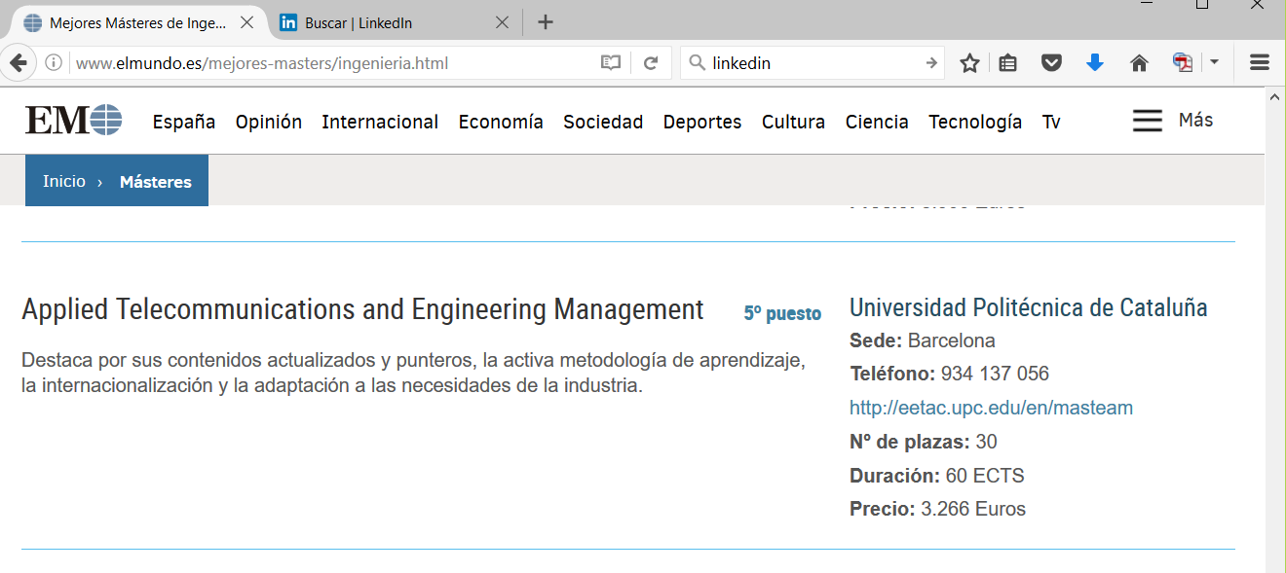
MASTEAM
“Mejores 5 másteres de Ingeniería en España 2016”
  http://www.elmundo.es/mejores-masters/ingenieria.html

Slide 4

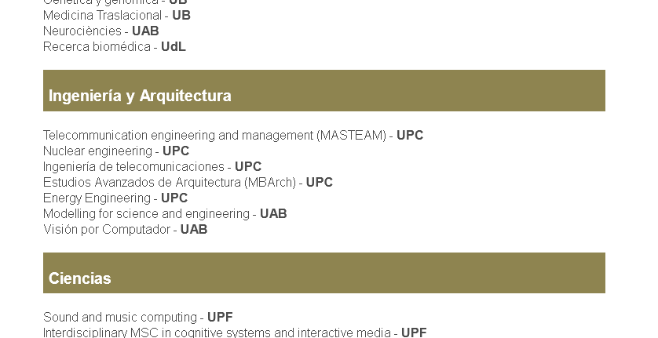
MASTEAM
“Master of Excellence” grants by FCLP
  Best candidate receives 5000 euros grant
  http://www.fundaciocatalunya-lapedrera.com/es/content/becas-m%C3%A1steres-de-excelencia

Slide 5
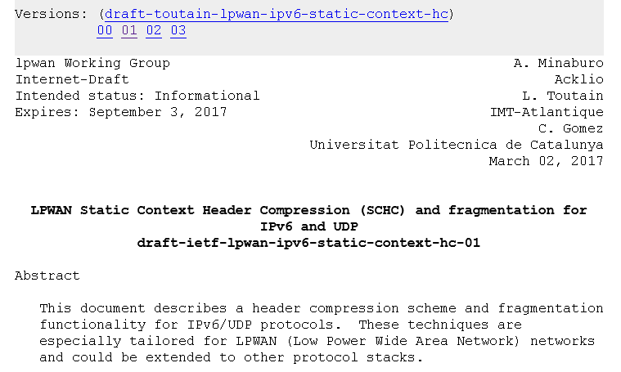
Faculty & Research
World-class research in the areas of the master

Slide 6
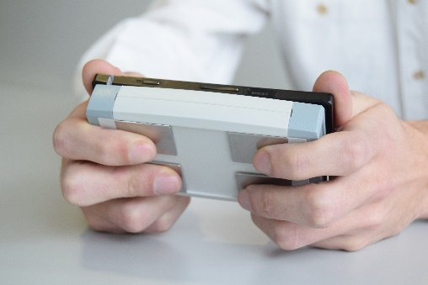
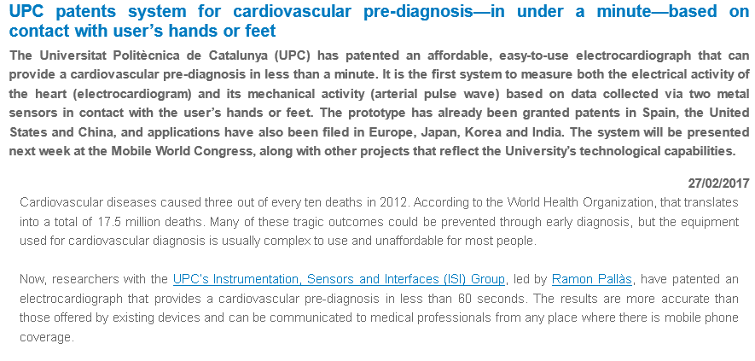
Faculty & Research
World-class research in the areas of the master

Slide 7
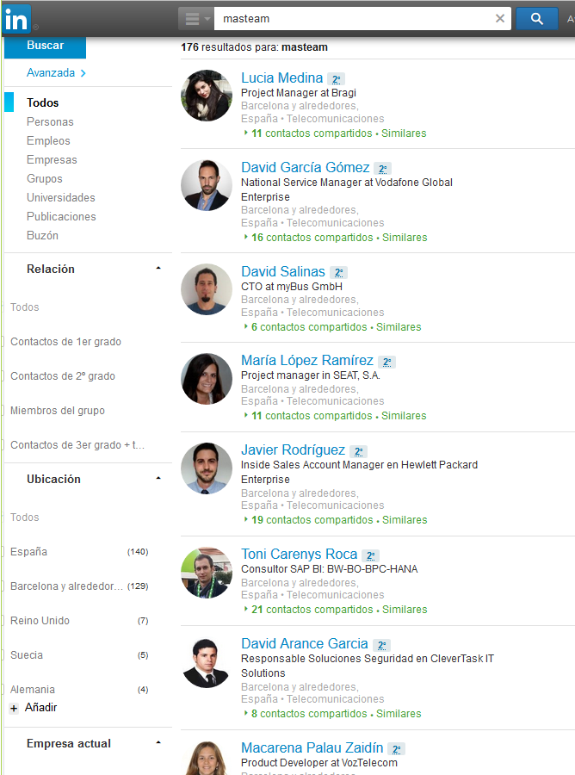
Alumni
LinkedIn: 170+ contacts

Slide 8
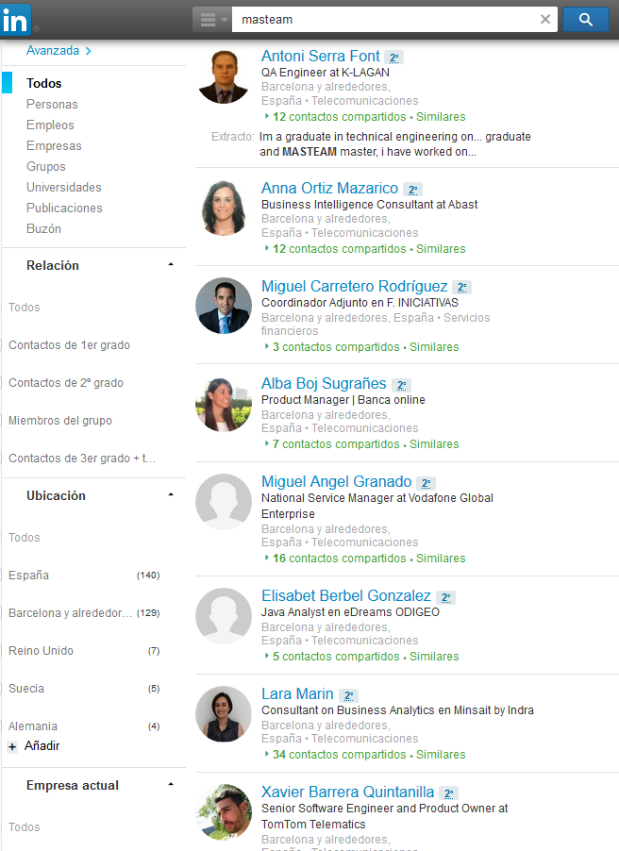
Alumni
LinkedIn: 170+ contacts

Slide 9
Structure
60 ECTS
  1 year at full-time, or 1.5, 2 or more at part-time
  1 ECTS = 9h of classroom activities + 16 h of autonomous activities
Mandatory contents: 15 ECTS
Optional contents: 33 ECTS
  Total optional offer: 42 ECTS
Master Thesis: 12 ECTS
  Performed during 2nd semester (full-time) or later

Slide 10
Semester 1A (14 weeks)
1A1 (7 weeks)
Optimization for Applied Engineering Design (3)
Network Engineering (3)
Next Generation Wireless Communications and IoT (3)
Sensors and Interfaces (3)
ICT-based Entrepreneurship (3)
1A2 (7 weeks)
Optical Networks for Cloud-Based Services (3)
IoT & Ubiquitous IP (3)
5G Mobile Network Planning (3)
Applied Image Processing (3)
Body Sensor Nodes (3)
Augmented Reality & Smart Objects (3)
Semester 1B (14 weeks)
1B1
Network Security Authentication & Authorization (3)
Big Data & Data Mining (6)
Master Thesis (12)
Low-power Systems with Energy Harvesting (3)
Software Defined Radio (3)
1B2
Service Engineering (3)
Creativity & Engineering (3)
Project on ICT-based Business Models (3)
In parenthesis, the number of ECTS credits
Mandatory course
Optional course

Slide 11
Mobility, Double Degree, Internships
Master Thesis in more than 30 institutions in Europe, China, Mexico…
Double Degree agreements
  1 year MASTEAM + 1 year abroad = 2 master degrees
    University of L’Aquila (Italy)
    Cranfield University (UK) – 8 different masters (automotive, aeronautical communications, etc)
    Currently finishing agreements with KTH (Stockholm - SWE), IST (Lisbon - PT), Karlstad (SWE)…
Internships
  Up to 600h, paid

Slide 12
Internships / Cooperation with companies
Master Theses, Internships
Currently we have more demand from companies than available students!
MASTEAM talks and presentations
  Cellnex: SIGFOX technlogy, business models
  Ficosa/Idneo: Connected car, Project management
  Ajuntament Barcelona: Smart City network, Security
  Datumize: Dark Data and IoT
  Schibsted: Networking in Container/Docker environments
  … check the EETAC website!

Slide 13
Questions ?

Slide 14
1A1
Optimization for Applied Engineering Design
  DEPT: ENTEL (3)
  Optimization with Engineering Applications
  Optimization Heuristics. Algorithms and complexity. Convergence
  Nature-Inspired Algorithms. Colonies and Swarms
  Biogeography-based techniques
Network Engineering
  DEPT: ENTEL (3)
  Introduction to large-scale dynamic systems
  Network models
  Competitive and cooperative systems
  Dynamic systems

Slide 15
1A1
Next Generation Wireless Communications and IoT
  DEPT: TSC (3)
  4G/5G networks
  Dense cell deployment: Small Cells, HetNets, Vertical HO
  Spectrum management: cognitive networks
  Cooperative communications: Network Coding
  WSN and Internet of Things
Sensors and Interfaces
  DEPT: EEL (3)
  Signal chain design
  Sensor performance assessment
  Analog sensors and signal conditioning
  Digital sensors and their interfaces
  Signal chain design

Slide 16
1A1
ICT-based Entrepreneurship
  DEPT: OE (3)
  Innovation models
  Business models of ICT-based companies
  Customer development. Lean startup concepts
  Canvas analysis
  Process analysis
  Sales for ICT-based startups

Slide 17
1A2
Next-Generation Optical Networks Infrastructures for Future Cloud-Based Services
  DEPT: TSC (3)
  Enabling technologies for advanced optical fiber-based networks
  Optical systems for cloud computing and data centers interconnects
  Enabling optical systems for energy-efficient optical networks
  Control/Management plane for optical transport networks
IoT and Ubiquitous IP
  DEPT: ENTEL (3)
  Internet evolution
  Internet of Things: technologies and applications
  Wireless experience enhancement
  Mobility support

Slide 18
1A2
5G Mobile Network Planning
  DEPT: TSC (3)
  Mobile system planning: coverage and capacity optimization
  Green networks: spectrum and energy efficiency
  HetNets
  Self-Organizing Networks (SON)
  Radio Resource Management and interference coordination.
Applied Image Processing
  DEPT: TSC(3)
  Recent advances in 2D and 3D image capture and representation devices.
  Next generation video coding standards for Ultrahigh-Definition and 3D systems
  Efficient algorithms for image segmentation
  Techniques for representation, description and analysis of color, motion and shape
  Image processing software tools for application oriented design

Slide 19
1A2
Low-power Systems with Energy Harvesting
  DEPT: EEL (3)
  Low-power embedded systems
  Analog front and back ends
  Power Management strategies
  Battery management and energy supervision
  Energy harvesting and power conditioning
Augmented Reality & Smart Objects
  DEPT: AC (3)
  Hardware for augmented reality
  Software and algorithms for augmented reality
  Smart object typology
  Applications

Slide 20
1B1
Service Engineering
  DEPT: ENTEL (3)
  Introduction to networked services
  Dimensioning of services
  Provisioning of telecom services
  Operations Management
  Conclusions, Advanced topics and Future trends
Body Sensor Nodes
  DEPT: EEL (3)
  Physiological and body position and movement sensors
  Low-noise sensor interfaces
  Interference reduction
  Sensor node implementation (Laboratory project)

Slide 21
1B1
Creativity & Engineering
  DEPT: OE* (3)
  Problem solving and killer applications
  Critical thinking and the role of the mind in learning
  Promoting creativity and team leadership
  Creative techniques
Big Data & Data Mining
  DEPT: AC (6)
  Storing big data
  Processing big data
  Tools and techniques to analyze big data
  Automatic recognition of patters in large data set
  Recommender systems
* Coordinated by Professor A. Elias (TSC)

Slide 22
1B2
Network Security Authentication & Authorization
  DEPT: ENTEL (3)
  Security Introduction
  Secure Storage of Credentials
  Passwords/credentials auditing
  User/service authentication
  Authenticated services and credential sharing
Software Defined Radio
  DEPT: TSC (3)
  Cognitive and Software Defined Radio
  Cloud-RAN
  Digital signal generation and processing strategies
  Advanced high-efficient transceiver architectures
  Linear and nonlinear characterization and compensation

Slide 23
1B2
Project on ICT-based Business Models
  DEPT: OE (3)
  Planning activities to develop a new business model
  Project management
  Generation of an innovative idea (students project, first part)
  Activity plan to develop a new business model (students project, second part)
  Selling the project (students project, third part)

